Slide 1





Gotham City
INTRODUCING THE NEW TIME AND ATTENDANCE APPLICATION

Slide 2

Table of Content
Introducing
Our solution
Easy to manage
Easy to use / Security
Questions

Slide 3
Introducing
In the business world, effective time management is crucial to the smooth running of a company. Timekeeping errors can lead to additional costs and administrative headaches.

Slide 4

Our solution
Our time and attendance solution offers a modern approach to solving these challenges. The application is designed to minimize data entry errors and optimize time tracking, simplifying the administrative processes involved in managing working hours.

Slide 5
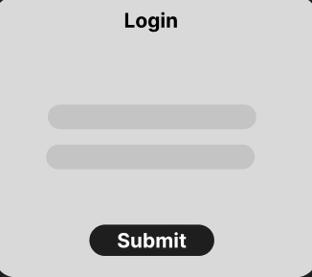

09
Easy to use and secure
One of the key features of our tool is its user-friendliness. The application is intuitive and easy to use, even for non-technophile employees. The user-friendly design ensures a quick and effortless check-in process, promoting rapid and efficient adoption within the company.

Slide 6

Easy to manage
For managers, our tool facilitates centralized supervision and management of working hours. Automated reports enable in-depth analysis of working time, facilitating decision-making based on accurate data. This improves operational efficiency and allows managers to devote more time to strategic activities rather than tedious administrative tasks.

Slide 7


Questions

